Slide 1

Department of Computer Science and Engineering
VNIT Nagpur
Document Verification of an Individual using Blockchain
Group 5
Abhishek Yadav - BT18CSE106
Vanshika Jain - BT18CSE107
Suyash Khade - BT18CSE117
Hardik - BT18CSE118
Shraddha Bhagawat - BT18CSE123
Under the guidance of
Prof. Manish P. Kurhekar
Notes:
Intro
Background - Data preserving and sxplorecurity
Blockchain tech
Applications - listIntro
Background - Data preserving and security
Blockchain tech
Applications - list
Apps explored
References
Intro
Background - Data preserving and security
Blockchain tech
Applications - list
Apps explored
References
Intro
Background - Data preserving and security
Blockchain tech
Applications - list
Apps explored
References
Apps explored
References

Slide 2

Problem at Hand
We realised that the background verification of an employee in the current hiring process is a tedious and cumbersome due to the following reasons:
Time required for sourcing background information
Labour cost or third party verification fees
Verify authenticity of past recruiters or manipulated data
Difficulty to verify data in case previous organization shutdowns
Notes:
In the current data age, a lot of data is generated each day and securely storing and sharing it is of utmost concern.
There are concerns about security, authentication, and validity of the data. One global truth about the data needs to be established. Many companies collect their customers’ data for analysis and marketing purposes to further improve on their business. Tech giants like Google, Facebook, Amazon collect a lot of user data and sell it to other businesses. They consider the user data to be their own, but the users need to have control over their personal data and should be able to track and manage it.

Slide 3

Proposed Solution
A single blockchain-based global platform for recruiting organizations to verify the background details of the applicants from all geographic locations.
We plan to create a consortium blockchain where universities, companies, and certification authorities have the privilege to write the information on to the blockchain. All these documents will be verified by an administrator node before calculating the hash values and saving them to the blockchain.
Notes:
Educational Institutions can submit the academic details like name of the program, list of courses taken, and grades etc.
students. All the information that you normally find on an academic transcript will be submitted to the
blockchain. Companies will submit the work experience details such as years of experience, skillset, and
performance ratings of all their employees on to the blockchain.

Slide 4

Our Requirements
Cost-efficient
Performance scalability
Privacy issues
Access control
Easy querying of data
Notes:
Most common consumers of this service would be organisations that issue important certificates
Cost-efficient - lesser transaction fees and Small and medium enterprises can also use this
All certificates have specific format and digital signature of issuing authority. Admin of org will verify the doc and transaction approved. Hash created of doc + SSN + last name and sent to orderer for pushing on bc
the hash values of all the original documents of a job applicant provided by various organizations are saved on a consortium blockchain. The job applicant’s details can be verified during the hiring process by comparing the hash value of the given document with the hash value of the document present on the blockchain.
Fabric layer consists of the public-key infrastructure, communication layer, databases, and the execution environment for smart contracts. People who develop and maintain the fabric layer of the blockchain control the whole system. The application layer, on the other hand, comprises application logic services that are used to implement smart contracts

Slide 5
Background Framework : Why Hyperledger?
The technology that will help the most is Consortium Blockchain. We plan on using Hyperledger Fabric because:
Open-source (no transaction fees)
Limit the number of nodes that can store or query data, using channel permissions
Allows transfer of data between organizations without revealing it to whole network, using private data
Performance Scalability
High modularity
Configurable architecture
Rich querying capability using CouchDB: a document database which stores content as JSON
Notes:
Hyperledger Fabric is an open-source permissioned distributed ledger technology (DLT) platform
Couch db - Its data model is compatible with the current key/value programming model.
LevelDb - higher (complex) level queries nai h
Make API for each func and invoke them, create the architecture in the way we want no fixed pattern

Slide 6
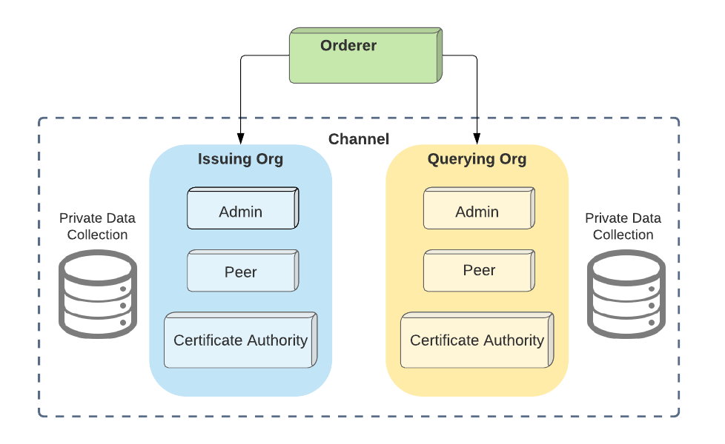
Components in the Network

Slide 7











Workflow
User requests for document verification from the certificate issuing authority
Admin verifies the document & if approved sends the hash values of identification and document to the orderer
When the user (applicant) approaches organizations, he/she submits them his documents
The application calculates the hash values of these and query the data on blockchain
An employee of this organization submits this certificate to admins connected to the blockchain
Orderer verifies admin’s approval and updates entry in blockchain
Recruiter submits applicant’s identification and document to an application
If the hash values match, document authenticity is proved
Notes:
A user requests for a transaction which is represented using a block. This block is broadcasted to all the nodes in the network. If 51% of the nodes verify this block, then it is added to the chain and the transaction is executed. This acceptance by 51% of the nodes is called proof of work. Another concept can be proof of stake where each node can verify based on how much stake it it has in the overall chain. I request Abhishek to continue explaining case studies from here.

Slide 8
Hands on with Hyperledger

Slide 9
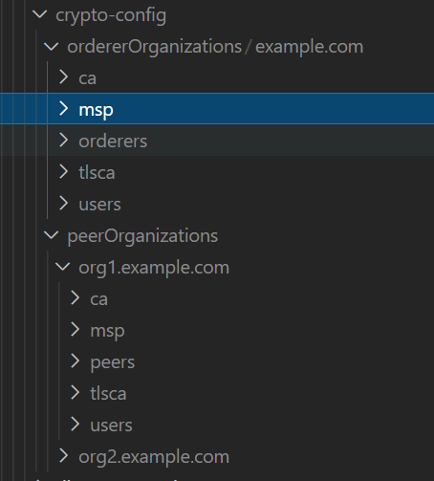
Step 1: Cryptogen tool to create organizations (peers), msp for each organization and crypto material for each (certificates, users)
Setting Up the Crypto Material
Folder structure formed after executing the above command

Slide 10
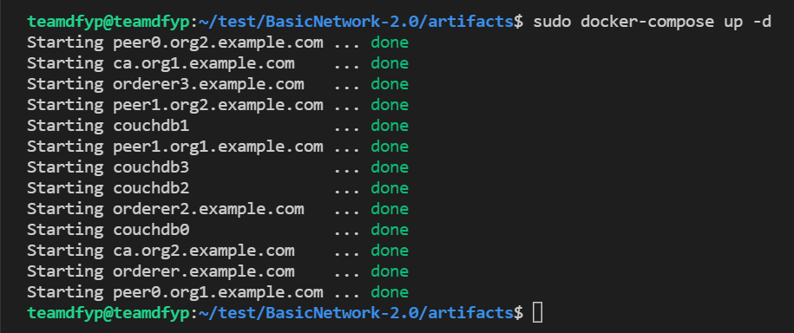
Creating genesis block and channel configuration block
Creating anchor peers for each organization
Creating docker containers for Certificate Authorities (CA), Peers, Orderers, and CouchDB
Setting up Network

Slide 11
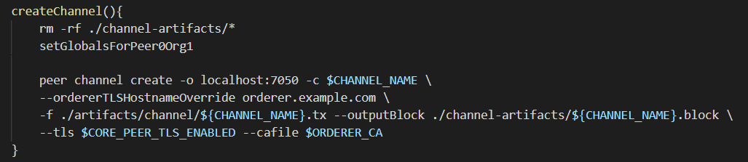
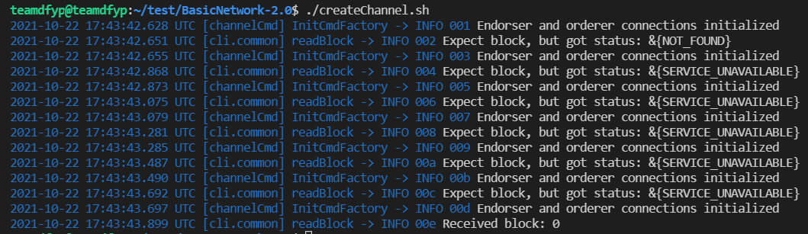
Creating Channel
Setting environment variables for each peer and orderer and creating channel using given function

Slide 12
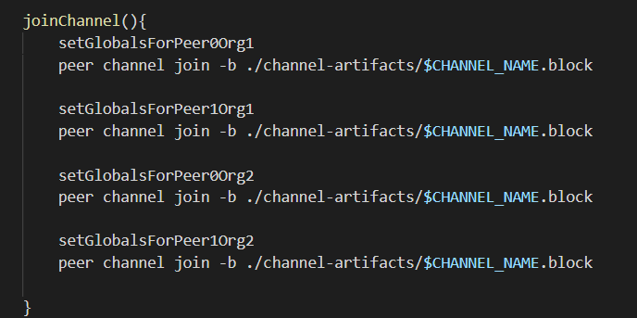
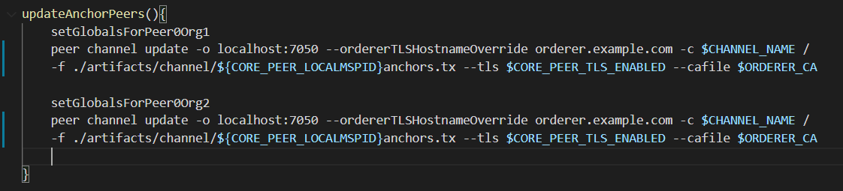
Joining the Channel
Joining all peers of each organization to the channel
Updating anchor peers to discover about other nodes (peers) on the channel

Slide 13
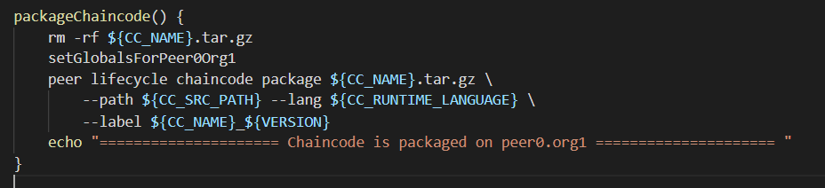
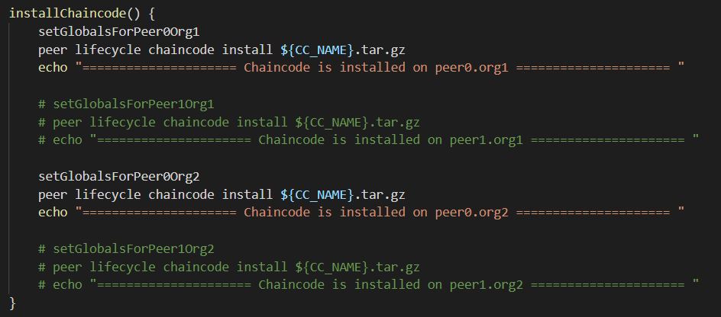
Packaging and installing Chaincode

Slide 14
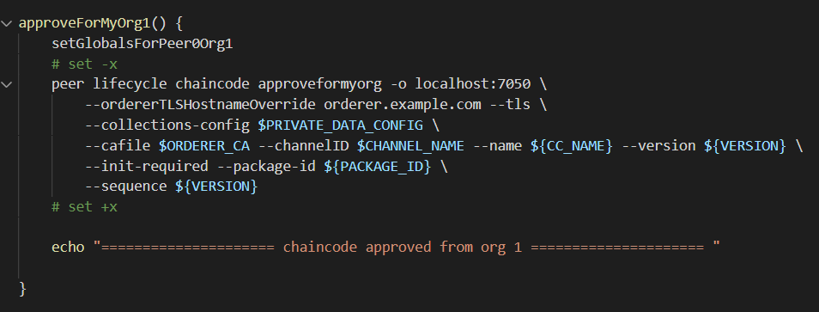
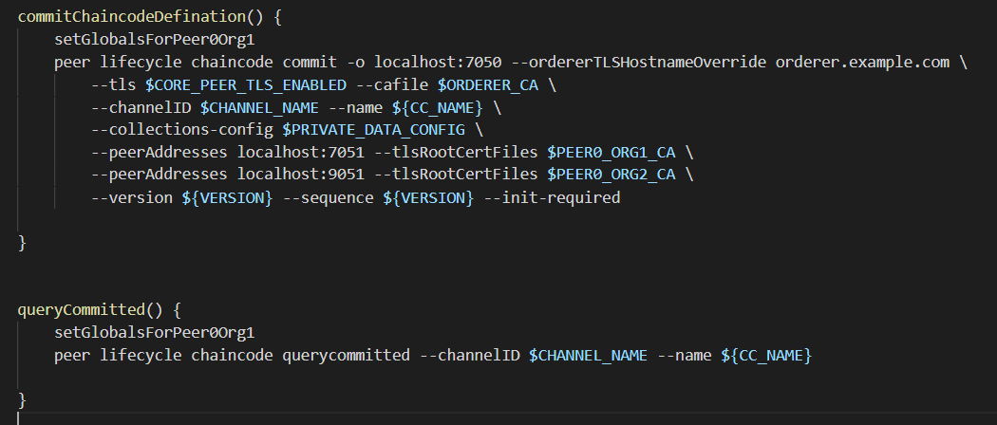
Approve installed chaincode for each organization
Commit chaincode definition and query committed
Approve and Commit Chaincode

Slide 15
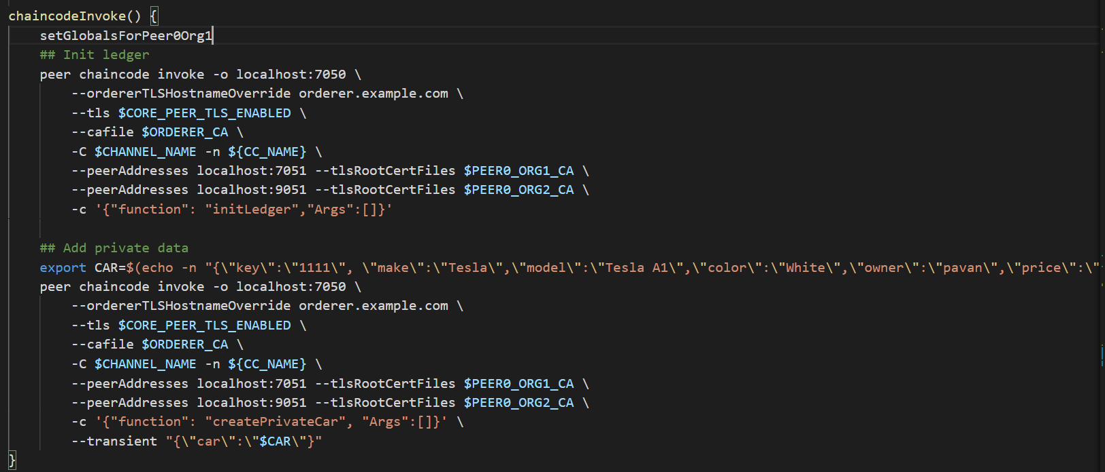
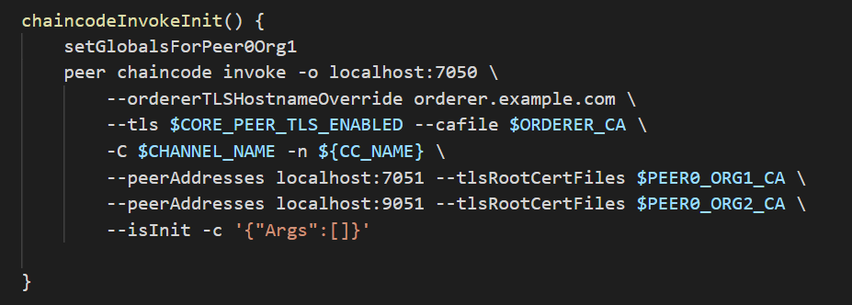
Invoking Chaincode

Slide 16
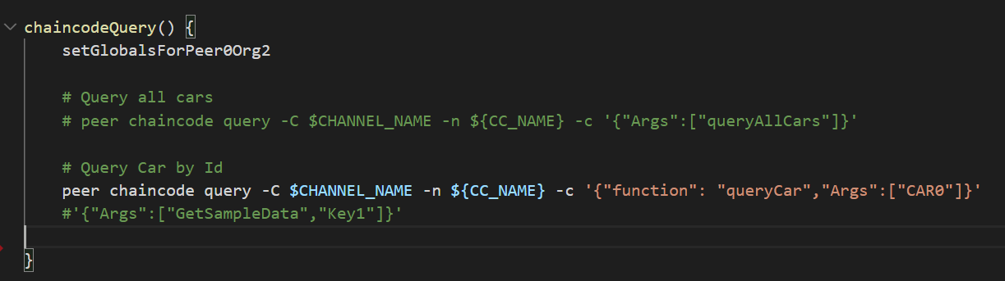

Querying the chaincode for CAR0

Slide 17
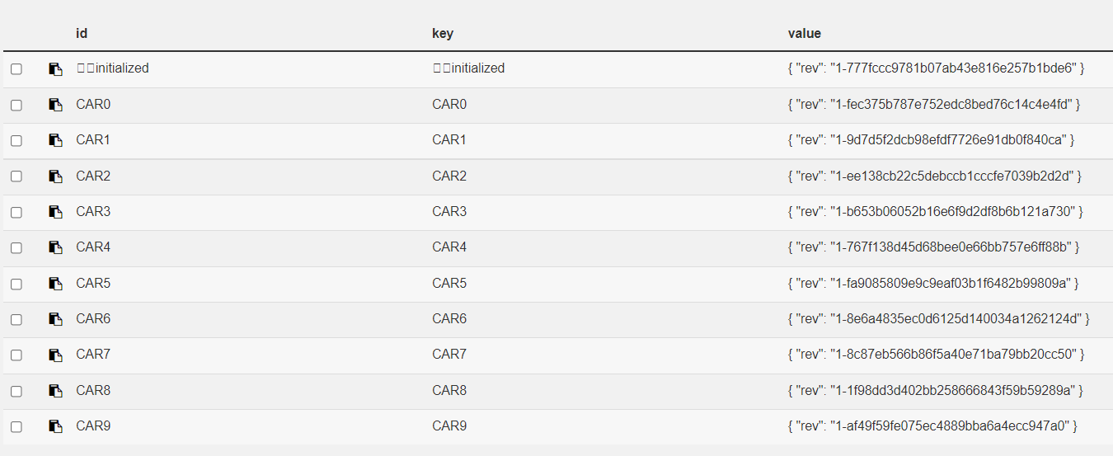
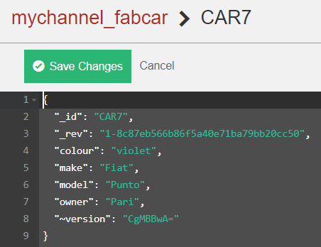
CouchDB State Database

Slide 18
Milestones
Data Sharing and Privacy Preserving Solutions using blockchain
Finalize problem statement and check already existing models
Improve on the system and add some unique features.
Aug | Sep | Oct | Nov | Dec | Jan | Feb | Mar | Apr | May
Explored case studies like real estate market, ex-employee traceability and import-export
Develop a basic system covering base functionality of problem.
Write research paper

Slide 19
Thank You

